Slide 1
CLASSIFICATIONS OF PARTIALLY EDENTULOUS ARCHES

Slide 2
CONTENTS
Introduction
Need for classification
Requirements of an acceptable method of classification
Definition
Various classifications
Modifications
ICK classification system for partially edentulous arches
Summary
References

Slide 3
INTRODUCTION
It is estimated that there are over 65,000 possible combinations of teeth and edentulous spaces in opposing arches.
Several methods of classification of partially edentulous arches have been proposed.
Notes:
The primary purpose of creating a classification system for partially edentulous arches is to enable the dentist to clearly communicate to a listener or reader about the condition of oral cavity in which missing teeth are to be replaced with a prosthesis

Slide 4
Complexity is determined from four broad diagnostic categories that include location and extent of edentulous areas, condition of abutments, occlusal characteristics and requirements and residual ridge characteristics.
Notes:
A classification that is based on diagnostic criteria has been proposed for partial edentulism. The purpose of this system of classification is to facilitate treatment decisions on basis of treatment complexity.

Slide 5
NEED FOR CLASSIFICATION:
To formulate a good treatment plan.
To anticipate the difficulties commonly to occur for particular design.
To communicate with professionals.
To design the prosthesis according to occlusal load usually expected for a particular group.

Slide 6
Requirements of an acceptable method of classification
It should permit immediate visualization of the type of partially edentulous arch.
It should permit immediate differentiation between the tooth-borne and the tooth and tissue supported removable partial denture.
It should be universally acceptable.

Slide 7
Definition
It a scientific grouping or the division based on essential similarities.

Slide 8
CLASSIFICATIONS
Cummer’s system – 1921
The Kennedy System – 1923
Baily’s system – 1928
Neurohrs System – 1939
Mauks system – 1941
Godfrey’s system – 1951
Beckett’s system – 1953
Friedman’s system – 1953

Slide 9
The Austin Ledge – 1956
The Skinner’s system – 1957
The Applegate – Kennedy system – 1960
Swensons System – 1960
Avants System – 1966
Classification of the distal extension problem
ICK classification

Slide 10
CUMMER IN 1920
He classified partial dentures into four types depending on the position of the retainers.

Slide 11
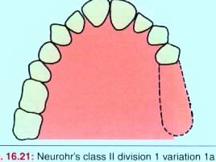
.TYPE 1
Notes:
1) Diagonal- Partially edentulous arch in which two diagonally opposite teeth are chosen as abutment teeth for attachment of the direct retainers with an indirect retainer as an auxillary attachment.

Slide 12
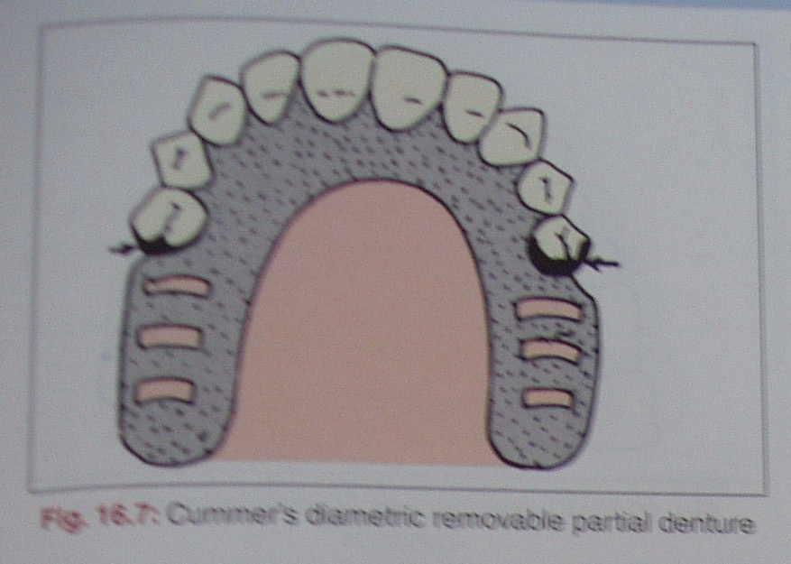
Type 2
Notes:
2) Diametric- Two retainers diametrically opposite one another.

Slide 13
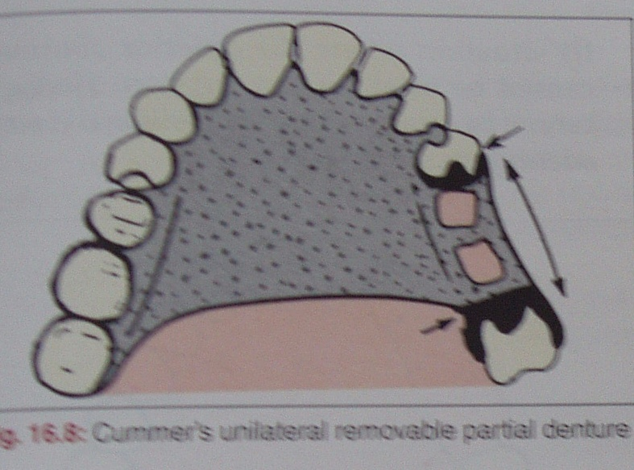
Type 3
Notes:
3) Unilateral- Two or more direct retainers on the same side.

Slide 14
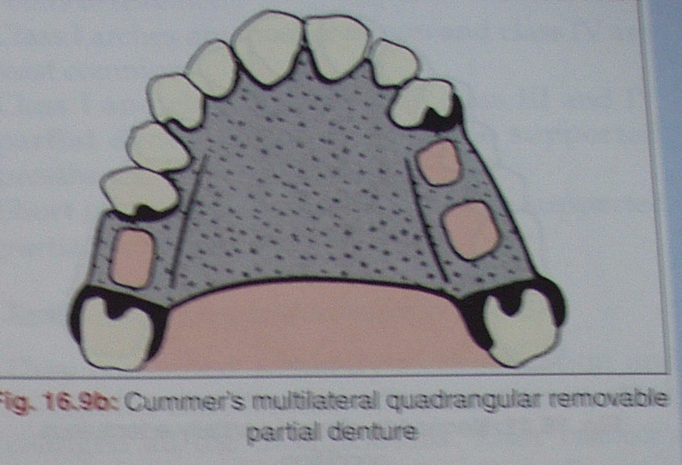
Type 4
Notes:
4) Multilateral- A partially edentulous arch in which two or more teeth are chosen as abutment for the of the direct retainer

Slide 15
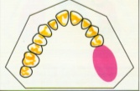
Class2- Unilateral free end saddle.

Slide 16
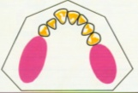
KENNEDY IN 1923
Class1- Bilateral free end saddles.
Notes:
He did not classify dentures, but classified partially edentulous spaces.
His classification related the edentulous spaces to the remaining teeth.

Slide 17
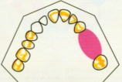
class 3-Unilateral bounded saddle.

Slide 18
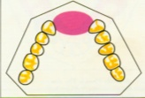
Class4- Single bounded saddle anterior to abutment teeth.

Slide 19
Applegate-Kennedy Classification
Classified partially edentulous arches based on kennedys classification.
If ant any teeth require extraction it should be done prior to classification.

Slide 20
Applegate has given 8 rules as follows
RULE 1- Classification should follow rather than precede any extraction of teeth that might alter the original classification.
RULE 2- If a third molar is missing and not to be replaced, it is not considered in the classification.

Slide 21
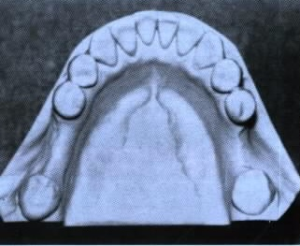
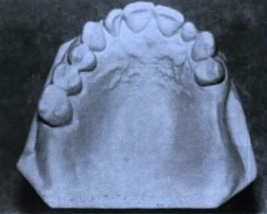
RULE 3- If a third molar is present and is to be used as an abutment, it is considered in the classification.
RULE 4- If a second molar is missing and is not to be replaced, it is not considered in the classification.

Slide 22
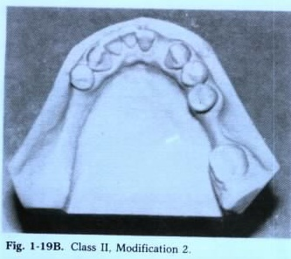
RULE 5- The most posterior edentulous area always determines the classification.

Slide 23
RULE 6- Edentulous areas other than those determining the classification are referred to as modifications and are designated by their number.
RULE 7- The extent of the modification is not considered, only the number of additional edentulous areas considered.

Slide 24
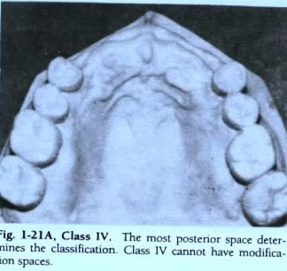
RULE 8- There can be no modification areas in class4 arches.

Slide 25
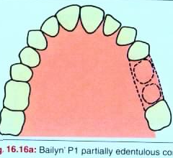
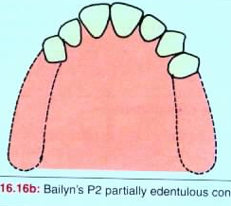
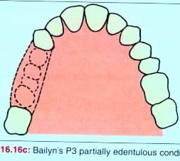
BAILYN IN 1928
Class 1- Bounded saddle (not more than three teeth missing).
Class 2-Free end saddle (there is no distal abutment).
Class 3 –Bounded saddle (more than 3 teeth missing).
Notes:
A- Anterior restorations, where there were saddle areas anterior to the first bicuspid.
P- Posterior restorations, where there were saddle areas posterior to the canines, and in addition:

Slide 26
Neurohr’s System 1939
Class 1 –Tooth bearing.
Class 2 –Tooth and tissue bearing.
Class 3 –Tissue bearing complete denture.

Slide 27
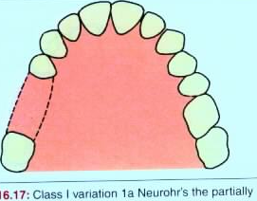
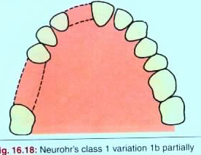
Class I – Tooth-bearing
There are two possible variation: Missing posteriors predominate.
A.Posteriors missing, anteriors in place.
B.Posteriors missing, some anteriors missing.

Slide 28
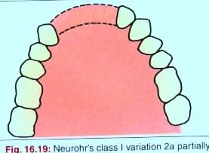
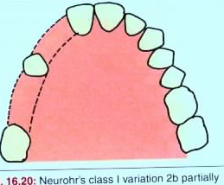
Variations 2-missing anteriors predominate
A.Anteriors missing, posteriors in place.
B.Anteriors missing, some posterior missing.

Slide 29
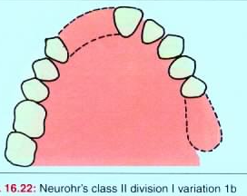
Class II – Tooth and tissue bearing
Division 1- When there are no teeth posterior to one or more spans. Variation 1 -Missing posteriors predominate. a)Posteriors missing anteriors in place. b)Posteriors missing and some anteriors missing

Slide 30
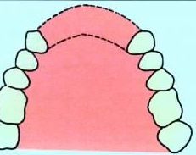
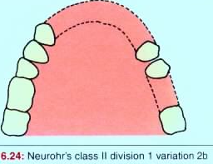
Variation 2- Missing anteriors predominate. Anteriors missing some posteriors missing

Slide 31
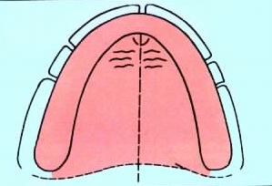
Class 3-Tissue bearing complete dentures. The complexity of any neurohrs classification is obvious and seldom used.

Slide 32
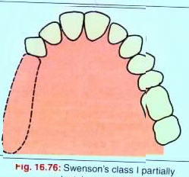
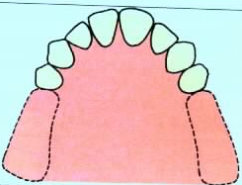
Swenson’s Classification:
Class I : In arch with one free end denture base.
Class II : In an arch with two free end denture base.

Slide 33
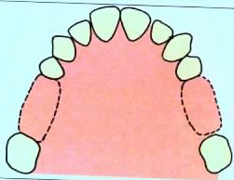
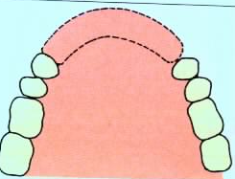
Class III : In arch with an edentulous space posteriorly; on both sides.
Class IV : In arch with anterior edentulous space.

Slide 34
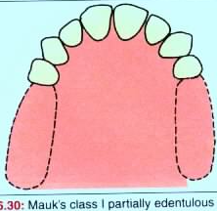
MAUK IN 1941
Class1- Bilateral posterior spaces and teeth remaining in a segment in the anterior region.
Notes:
He proposed a classification based on the number, length and position of the spaces, and the number and position of the remaining teeth.

Slide 35
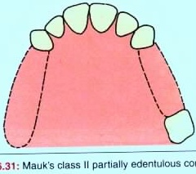
Class2- Bilateral posterior spaces and one or more teeth at the posterior end of one space

Slide 36
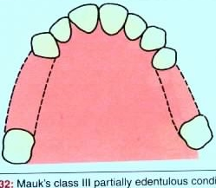
Class3- Bilateral posterior spaces and one or more teeth at the posterior end of both spaces.

Slide 37
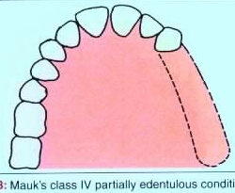
Class4- Unilateral posterior space with or without teeth at the posterior end of the space.

Slide 38
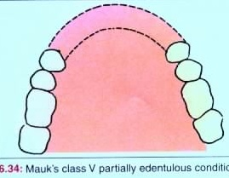
Class5- An anterior space only

Slide 39
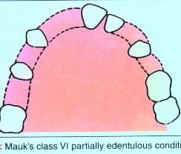
Class6- Irregular spaces around the arch

Slide 40
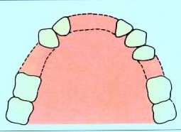
WILD IN 1949
He proposed a simple but self explanatory classification.
Class1- Interruption of dental arch(bounded).

Slide 41
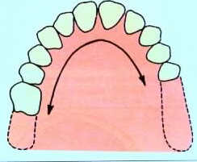
class2- Shortening of dental arch(free end).

Slide 42
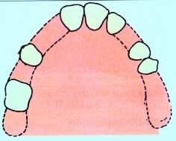
Class3- Combination of 1 and 2.

Slide 43
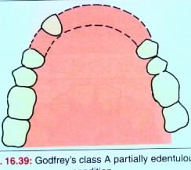
Godfrey’s System in 1951
Class A- Anterior tooth bounded space.

Slide 44
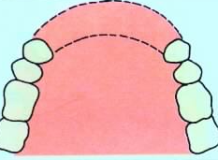
Class-B: Has mucosa borne bases in the anterior of the mouth with 4 or 5 tooth space.

Slide 45
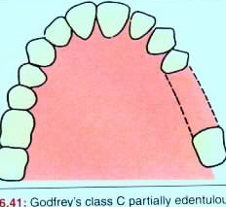
Class-C: Has tooth borne denture base in posterior part. It may be unbroken 3 tooth space or 2 tooth space.

Slide 46
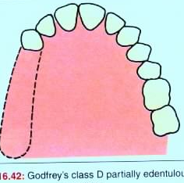
Class-D: Has mucosa born denture bases in posterior part of mouth. It may be unbroken 4 or 5 teeth space.

Slide 47
Beckett’s Classification:
In 1953 Dr.Leonard S. Beckett.
Class I : Bases with tooth borne.
Class II : Saddles which are tissue borne.

Slide 48
Class III : Inadequate abutments to support the base and probably, inadequate mucosa support

Slide 49
Friedman’s Classification:
CLASS -A
CLASS-B
Notes:
By Dr.Joel Friedman in 1953
Letter-A: Designates an anterior space.
Letter-B: Designates a bounded posterior space.

Slide 50
CLASS - C
CLASS- D
Notes:
Letter-C: Refers to a cantilever situation or posterior free end space.
D- Combination of A-B-C spaces.

Slide 51
Austin-Lidge Classification:
Classs-A1
Class-A2
Notes:
Class A1 : Missing anterior tooth on one side only.
Class A2 : Missing on both sides.

Slide 52
Class - P1
Class -P2
Notes:
Class P1: Posterior teeth missing on one side only.
Class P2: Missing on both sides.

Slide 53
Class AP: Has anterior and posterior teeth missing.
Class -A1P1

Slide 54
Class -A2P2

Slide 55
Skinner’s System:
Class-I : Has abutment teeth located both anterior and posterior to it.
Class-II: Has all the teeth posterior to it.
Class-III: Has all the abutment teeth anterior to it.
Class IV: Has denture base located both anterior and posterior to it
Class V: Abutment teeth is antero-lateral in relation.
Notes:
Proposed by Dr.C.N. Skinner in 1957.

Slide 56
Avant’s Classification:
Class I : Replaces one or more posterior teeth on one side of arch.
Class I-F: Replaces teeth on terminating free end.
Class-II : Replaces one or more teeth on both sides of arch.

Slide 57
Classification of Distal Extension Problem:
Unimaxillary:
-Unilateral A, B, C or D missing
-Bilateral A & B or C & D missing
Bimaxillary:
-Unilateral A & C or B & D missing
-Bilateral A & B or C & D missing
-Contralateral A & D or B & C missing

Slide 58
COSTA IN 1974
His classification is based on anterior lateral and terminal spaces.

Slide 59
OSBORNE & LAMMIE IN 1974
Class1- Mucosa borne.
Class2- Tooth borne.
Class3- Combination of 1 and 2.
Notes:
He quoted a classification based on support of a denture as a whole.

Slide 60
ICK CLASSIFICATION(Implant-Corrected Kennedy (ICK) Classification System
The original Kennedy classification can be used to describe the situation without implants, and then the implant-corrected classification can be used to describe the situation with implants.
It means that the classification can be used either retrospectively to describe an existing situation, or prospectively for future planning
Notes:
This is a simple classification system for partially edentulous arches with implants based on the Kennedy classification system, with modification, to be used for RPDs. It incorporates the number and positions of implants placed or to be placed in the edentulous areas.

Slide 61
Guidelines for the new classification system
(1) No edentulous space will be included in the classification if it will be restored with an implant-supported fixed prosthesis.
(2) To avoid confusion, the maxillary arch is drawn as half circle facing up and the mandibular arch as half circle facing down. The drawing will appear as if looking directly at the patient; the right and left quadrants are reversed.

Slide 62
(3) The classification will always begin with the phrase "Implant-Corrected Kennedy (class)," followed by the description of the classification.

Slide 63
It can be abbreviated as follows:
(i) ICK I, for Kennedy class I situations,
(ii) ICK II, for Kennedy class II situations,
(iii) ICK III, for Kennedy class III situations, and
(iv) ICK IV, for Kennedy class IV situations.

Slide 64
(4) The abbreviation “max” for maxillary and “man” for mandibular can precede the classification. The word modification can be abbreviated as “mod.”
(5) Roman numerals will be used for the classification, and Arabic numerals will be used for the number of modification spaces and implants.
(6) The tooth number using the American Dental Association (ADA) system is used to give the number and exact position of the implant in the arch.

Slide 65
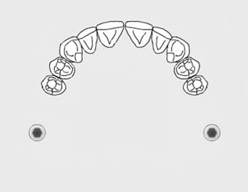
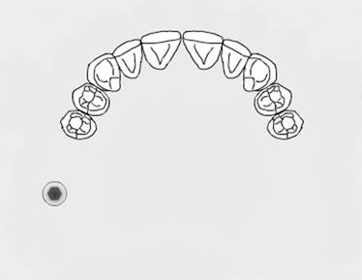
The proposed ICK classification system for partially edentulous arches
Examples for Kennedy class I situations:
Maxillary implant-corrected Kennedy class I or ICK I ( #2, 15)
ICK I ( #2)

Slide 66
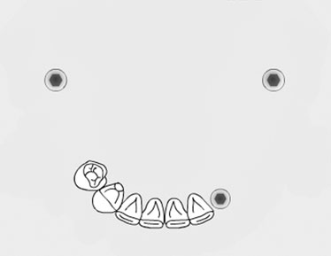
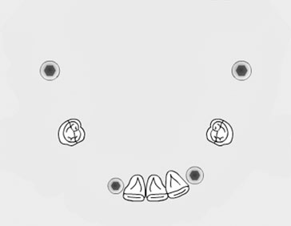
ICK Class I (# 18, 22, 31)
ICK I mod 2 (#18,22,26,31)

Slide 67
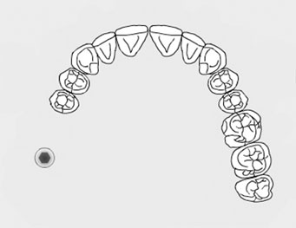
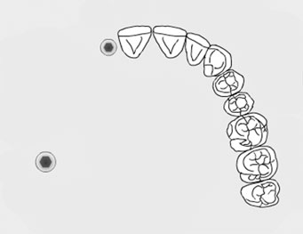
Examples for Kennedy class II situations
ICK II (#2)
ICK II (#2,7)

Slide 68
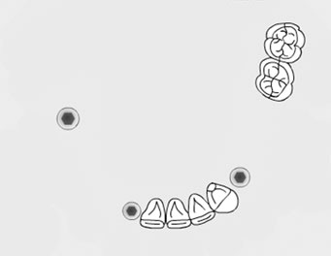
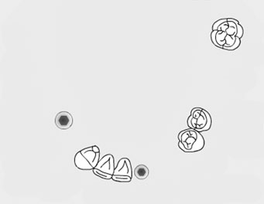
ICK II mod 1(#21, 26,30)
ICK II mod 2 (#24,29)

Slide 69
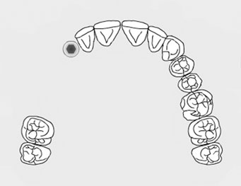
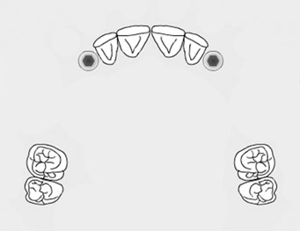
Examples for Kennedy class III situations
ICK III (#6)
ICK III mod 1(#6,11)

Slide 70
ICK III mod 3 (#23, 26)

Slide 71
Examples for Kennedy class IV situations
ICK IV (#6,11)
ICK IV (#19,22)

Slide 72
Summary:
Many classifications of partial denture have been proposed by different clinicians.
The confusion is not yet resolved and there is no universally accepted classification.
A classification is either one that describes the various tooth and saddle position like those of Kennedy, and others on one that looks more closely at the available support, like those of Baily’s and others.

Slide 73
Classification of Kennedy is useful describing basic outline of particular case. However it helps to form a common partial denture among colleagues.
It does not take into account the available support upon which the success or failure of any partial denture or bridge ultimately.

Slide 74
REFERENCES:
1)Clinical Removable Partial Prosthodontics – Stewart Rudd Kuebker.
2)McCracken’s Removable Partial Prosthodontics
3)Designing of Partial Denture – David M. Watt, A. Roy Mac Gregor.
4)Removable Partial Dentures – Earnest L. Miller.
5)Distal Extension Denture Base – Morton Amsterdam, JefrayIngbar.
6)Miller E.L. – Systems for Classification Partially Dentulous Arches. J. Prosthet. Dent. 24 : 25 : 40. 1970.
7)Owal BE and Taylor RLA, Survey of dentition and removable partial dentures constructed for patients in North American. J. Prosthet Dent. 61 : 465-470 : 1989.
8)ICK Classification System for Partially Edentulous Arches .American college of prosthodontics...Sulieman S. Al-Johany, BDS, MSD1 & Carl Andres, DDS, MSD2

Slide 75
THANK YOU :)

